Slide 1

Azure IoT Hub for Smart Factory
講者：Carl Yang

Slide 2
Challenges
多樣化的資料來源
不一致的資料格式
網路通訊的難易度
龐大的資料量

Slide 3
Azure IoT Hub

Slide 4
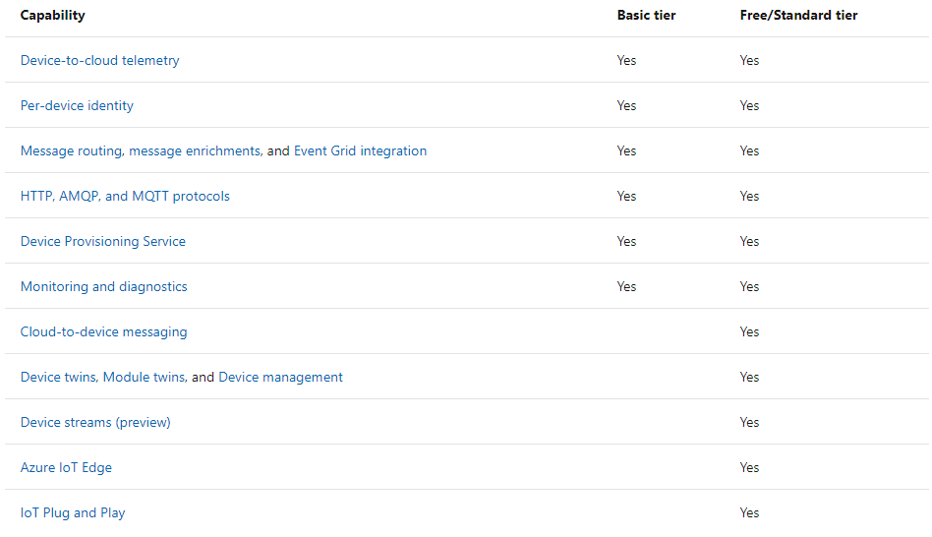
Scale
Free:
Only 1 per subscription
Basic:
Device-to-cloud
Standard:
Cloud-to-device
IoT Edge
Device Management
(Ref: https://docs.microsoft.com/en-us/azure/iot-hub/iot-hub-scaling)

Slide 5
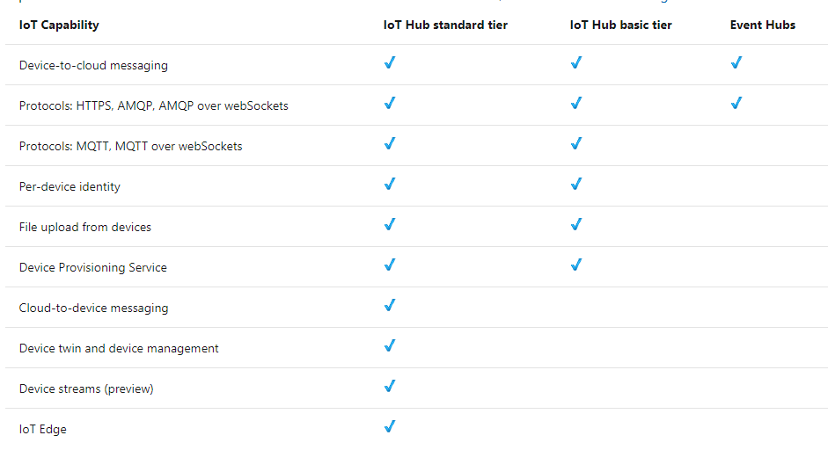
IoT Hub vs Event Hub
(Ref: https://docs.microsoft.com/en-us/azure/iot-hub/iot-hub-compare-event-hubs)
Notes:
AMQP、MQTT跟HTTP一樣是基於TCP/IP上的通訊協定、但更輕量，適合物聯網的小型裝置、網路頻寬不大的情境下使用。
Device Provisioning: 大量裝置部屬

Slide 6
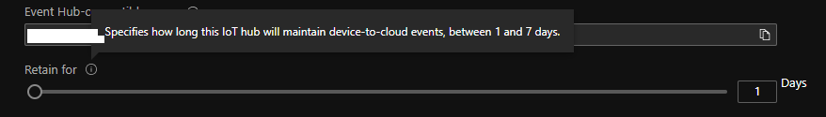
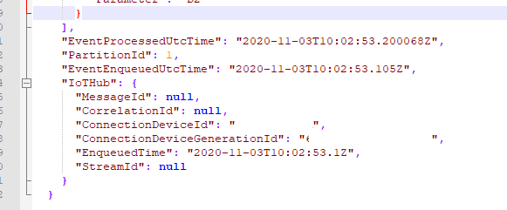
Telemetry
Cache: 1~7 days
Unified format
Unstructured
Data Centralizing
相同事件、相同時間

Slide 7
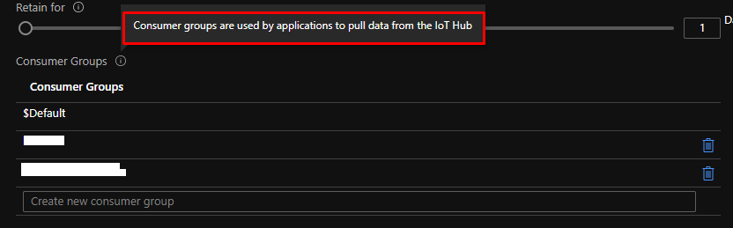
Consumer Group
Pulling data
Max. 20 consumer groups per IoT Hub
5 concurrent readers per group

Slide 8
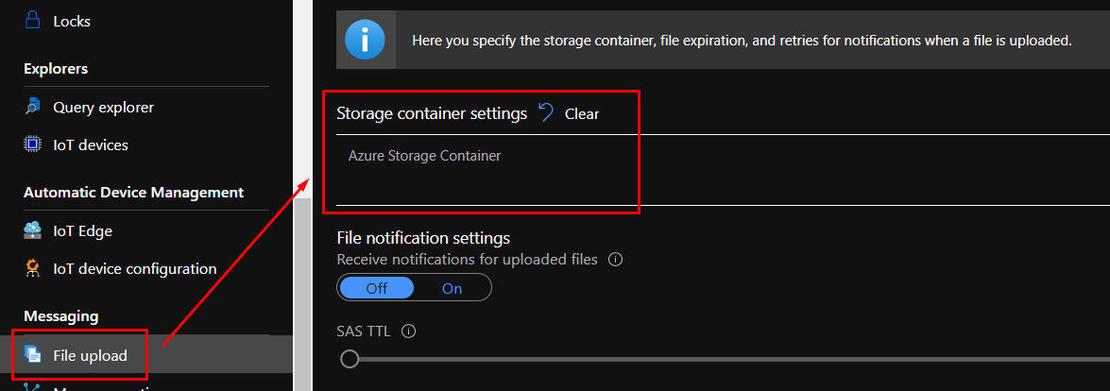
File Upload
Only Support Storage Container
Save data to blob files
Block Blob Only
10 concurrent keys in queue
同時10台裝置上傳，超過就會失敗

Slide 9
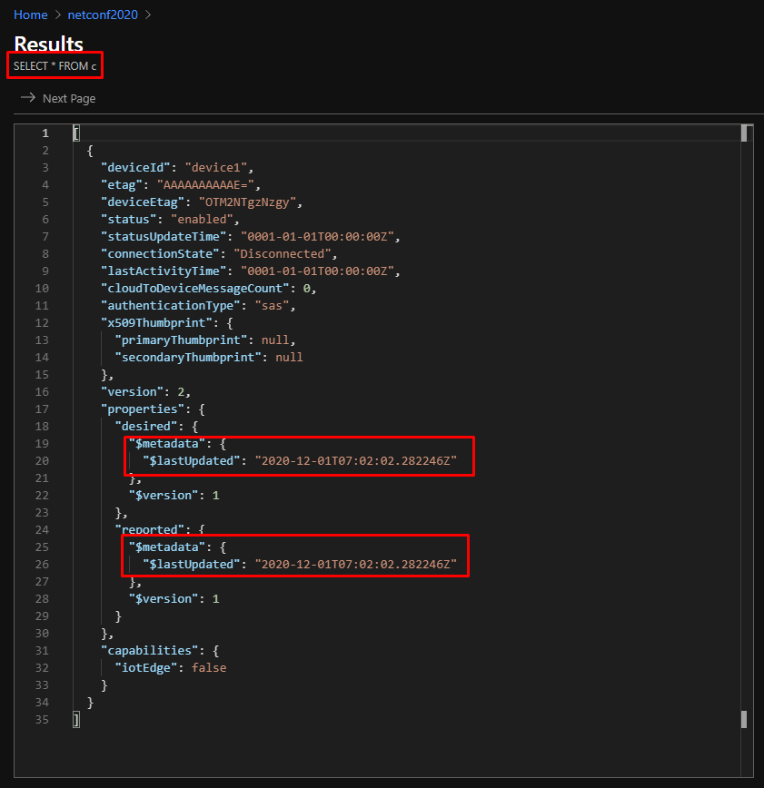
Query Explorer
Only in Standard Tier
Device Twins/Jobs
information
Help to manage devices

Slide 10
SDKs for Client
C: https://github.com/Azure/azure-iot-sdk-c
Python: https://github.com/Azure/azure-iot-sdk-python
Node.js: https://github.com/Azure/azure-iot-sdk-node
Java: https://github.com/Azure/azure-iot-sdk-java
.NET C#: https://github.com/Azure/azure-iot-sdk-csharp

Slide 11
Architecture

Slide 12
Data Flow
Monitor
Authentication

Slide 13
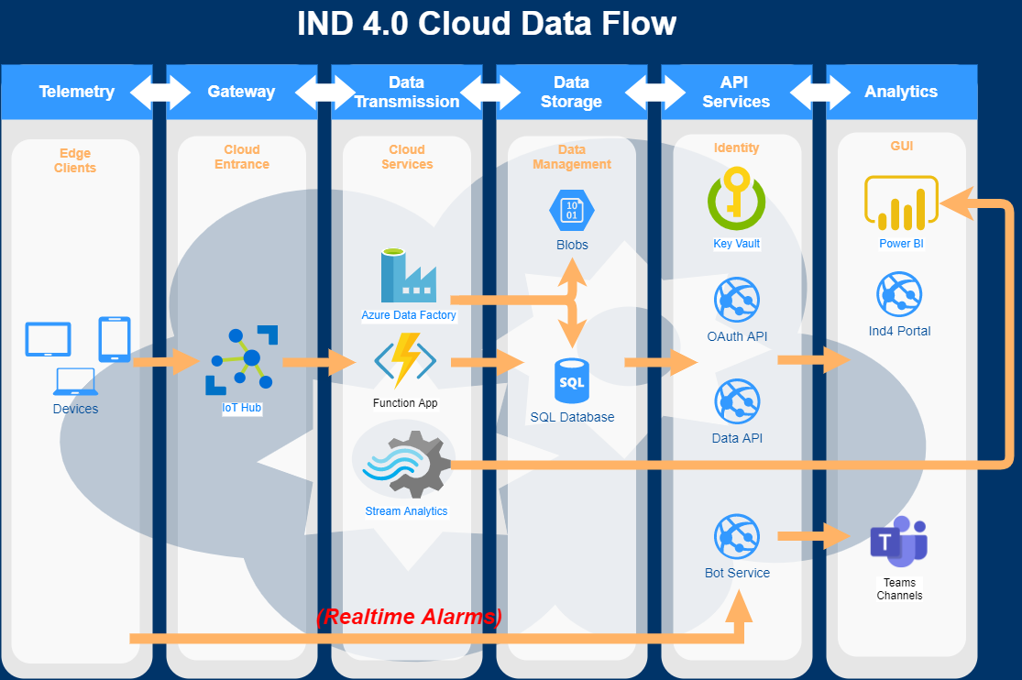
Data Flow

Slide 14
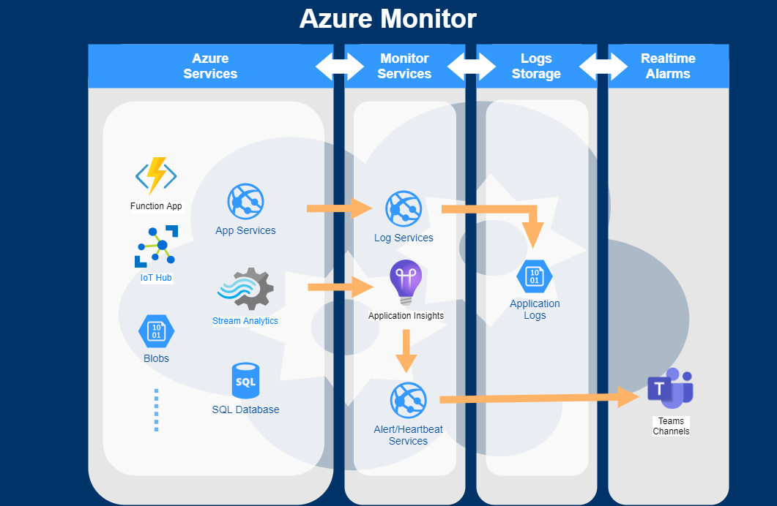
Monitor

Slide 15
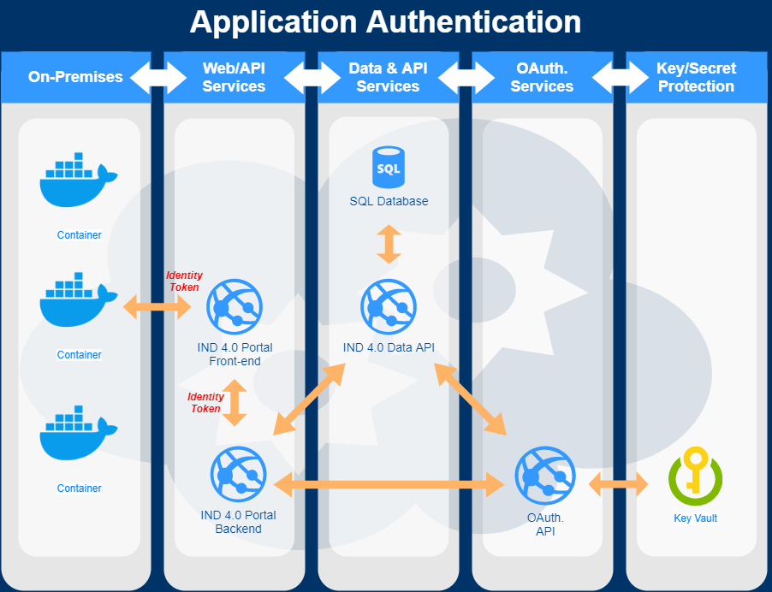
Authentication

Slide 16
Data

Slide 17
要用資料做什麼?
分析、警示、統計?
我們全都要!

Slide 18
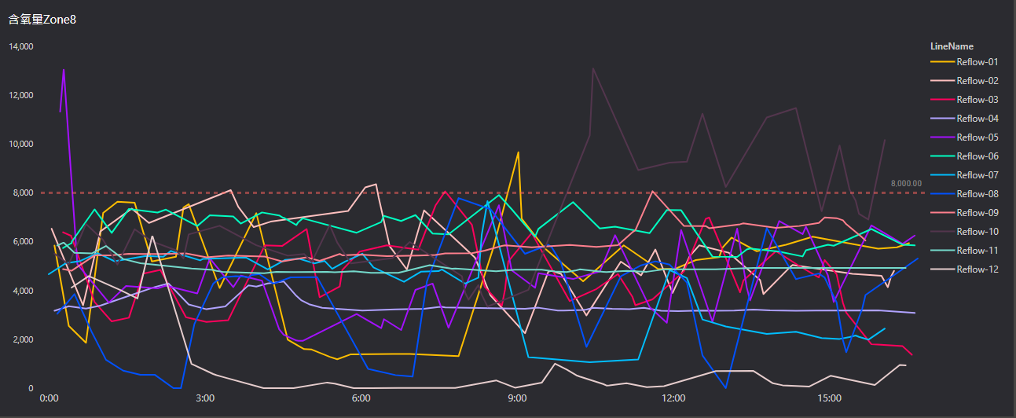
分析 – 以O2為例

Slide 19
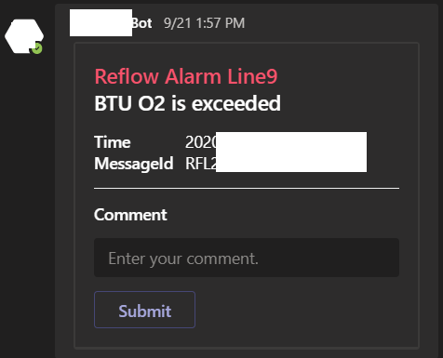
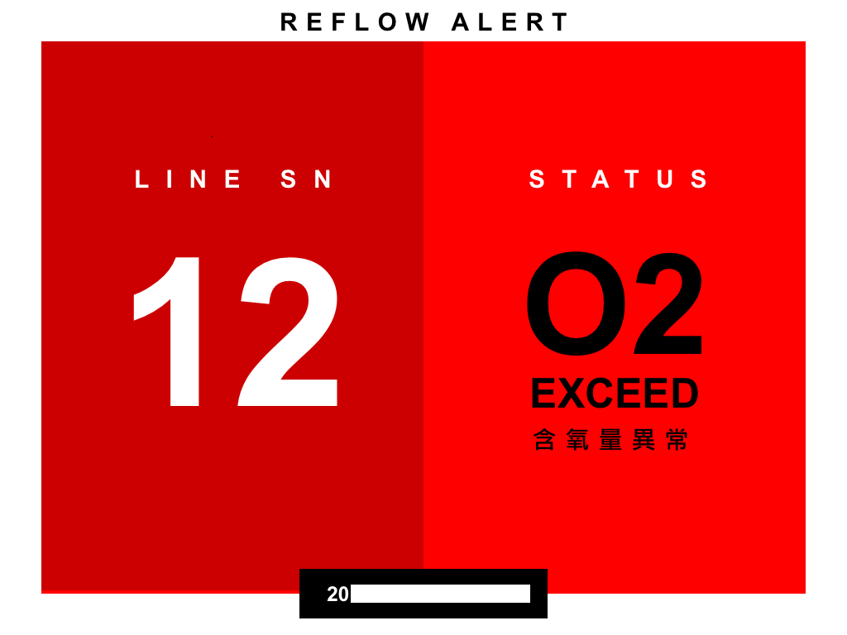
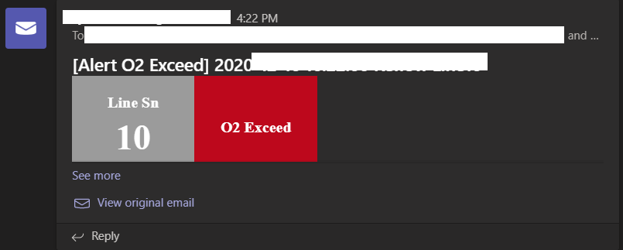
警示– 以O2為例

Slide 20
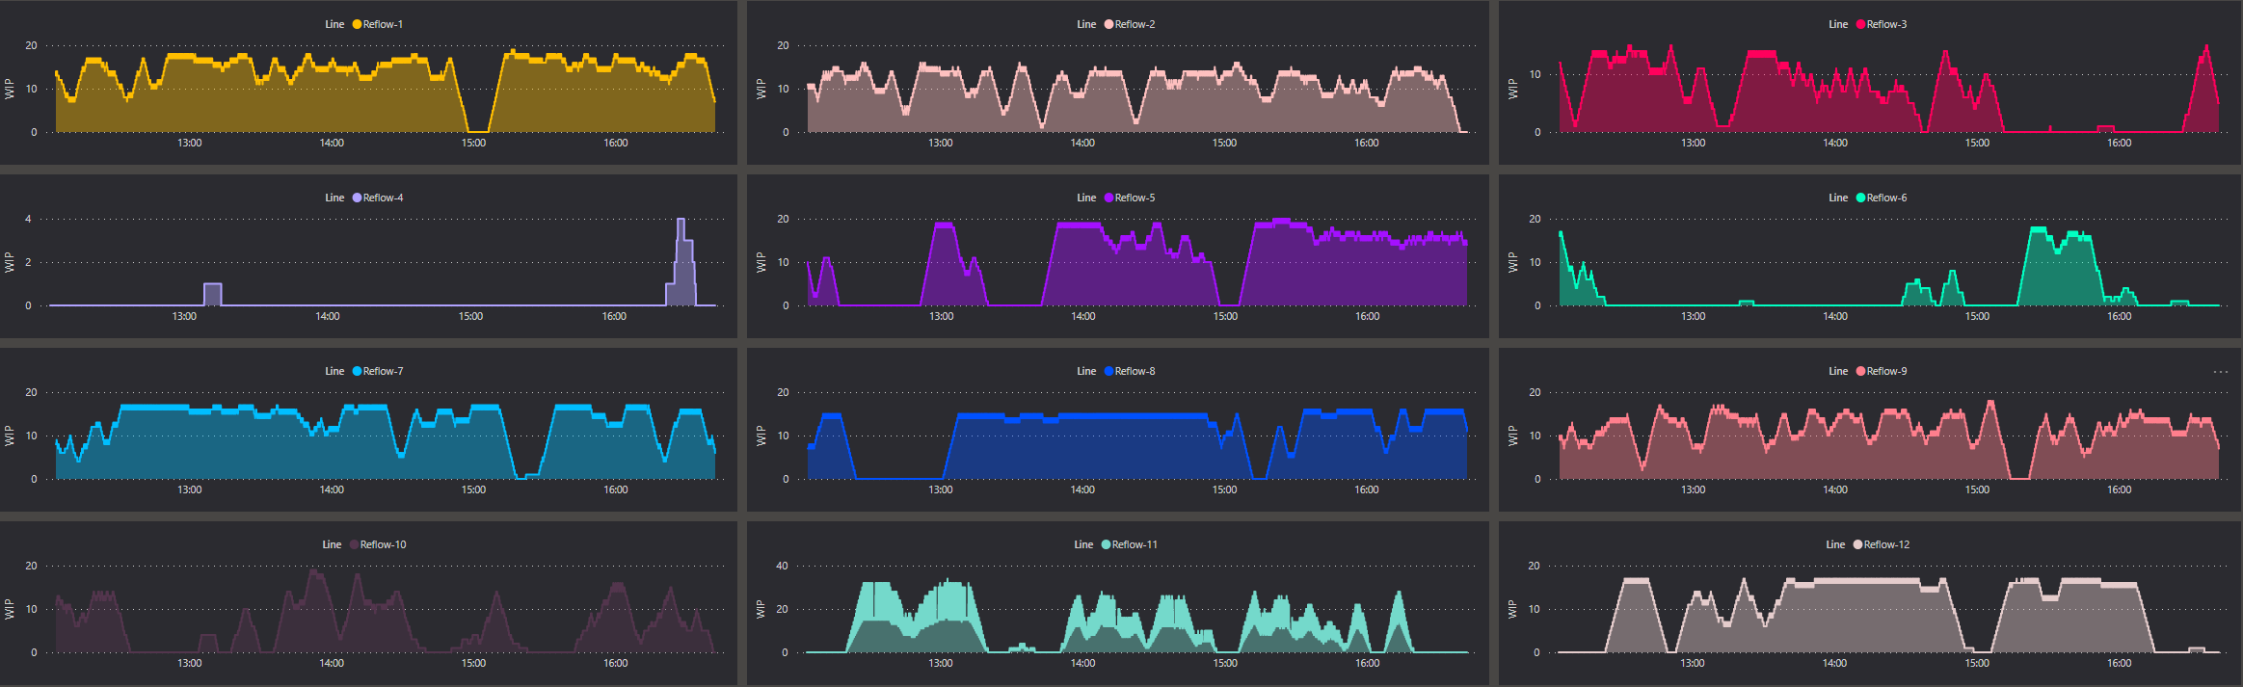
統計 – 以WIP為例

Slide 21
資料從哪裡來?
OCR、Devices、Machine Logs?
我們選擇Machine Logs!

Slide 22
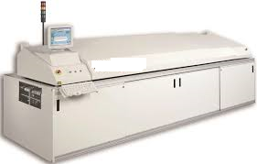
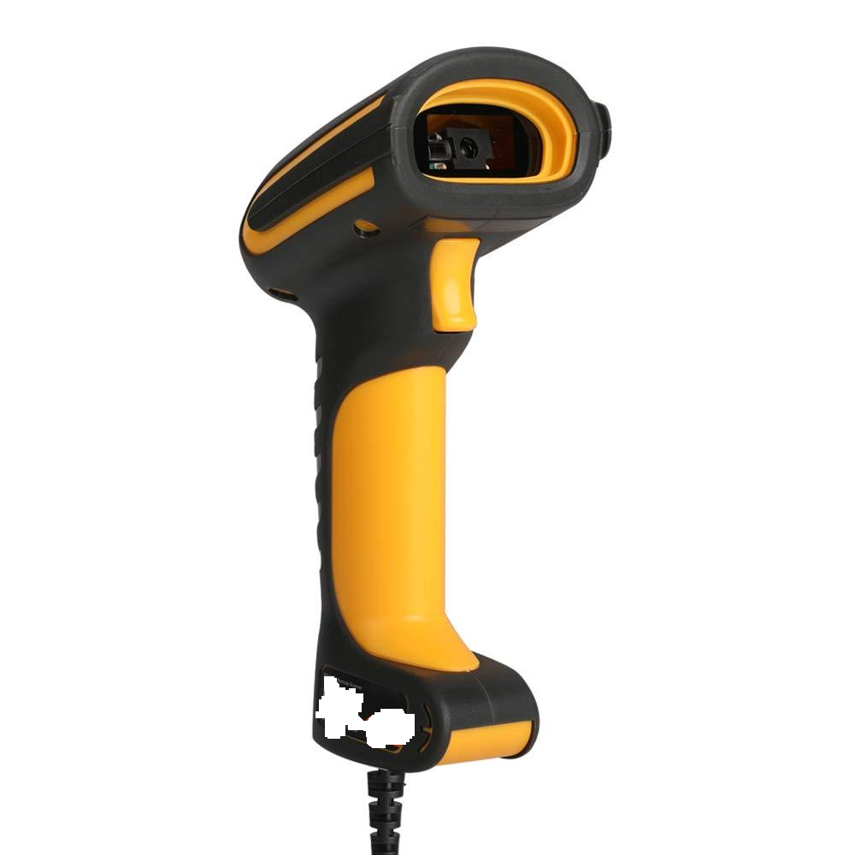
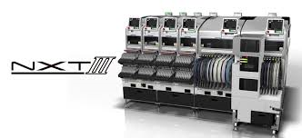
Sources
Various:
Bar Code Scanner:
Device Support
Weak Integration
OCR:
Visual Identification Machine
Machine Logs:
Native Machine Software Support
Stable

Slide 23
資料如何處理?

Slide 24
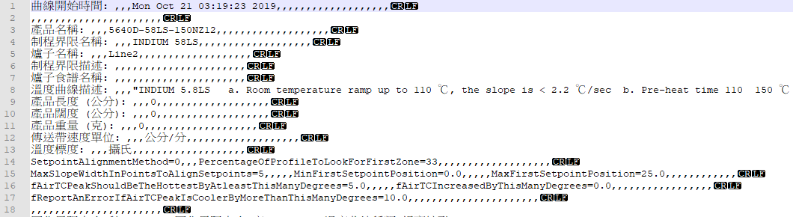
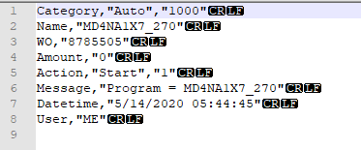

Various Data Structures
Various Data Schema:
Keep useful data
Re-organize structure
Merge/Divide Values
Use CSV for exchanging

Slide 25
Format
Not consistent:
欄位分隔符號不一致: 先replace、再Divide
Abnormal Values:
多個數值: 只留真正的資料
Value Type:
Read with STRING type first

Slide 26
Format
Multiple columns:
Use the column name closed to value
Hierarchy:
Set with real data hierarchy

Slide 27
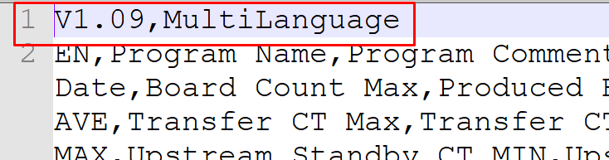
Format
Extra Information:
Remove it
Use it on-premises

Slide 28
Format
Column in value:
Manually Input
Confirm with user
Parse Value

Slide 29

Frequency
Scenario:
File Rename:
Ex. Test.csv -> Test.tmp
Append data per 1s
File Rename:
Ex. Test.tmp –> Test.csv

Slide 30

File Lock/Missing
Create/Update:
Sol:
Copying file first
Delete/Rename
Sol:
Filtering by full name
(ex. *.csv) then copying
Sol:
Filter by modify time
Hint: 不要跟機台比速度!

Slide 31

優化
If it can be … else …
Optimization:
Create/Update:
Create file instead of update, even if only one record
Delete/ Rename :
Not allowed

Slide 32

Read Local File
Network latency
Data Size
Divide & Conquer
單一檔太大，分開寫檔/讀檔。
Read/Write Frequency
讀寫檔案速度一定是本地端最快、最穩。
提升Host的I/O效能。

Slide 33
資料往哪裡送?怎麼送?
On-premises: DB/REDIS…etc
Cloud: Services?

Slide 34

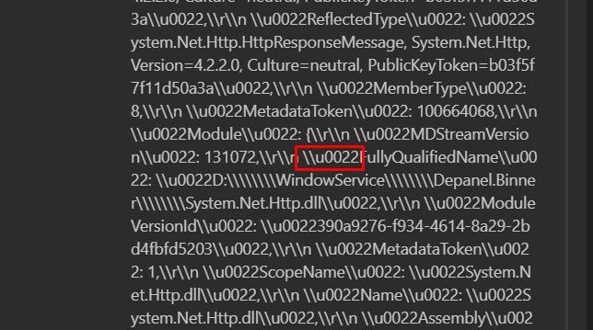

Principals for IoT Hub
256 KB per message
Make data size closed to 256 KB in each request
4 KB per unit
Reduce data size as possible, ex. \u0022
256 KB
1
256 KB
2
3
IoT Hub
128 KB

Slide 35
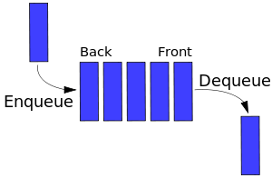
Memory Queue
Time Series
256 KB
256 KB
128 KB
IoT Hub
Latency

Slide 36
Application

Slide 37
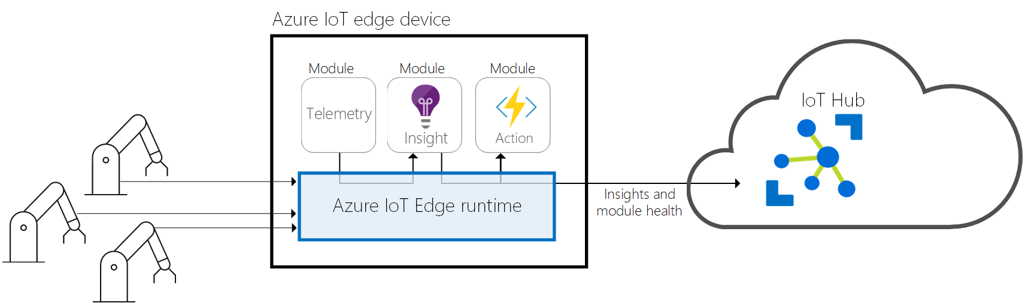
IoT Edge
最接近資料來源的機器
分散式計算
獨立運算能力
網路通訊能力

Slide 38


IoT Devices or Edge?
政策
遠端裝置管理
雙向通訊
Device Client作業環境
Device Client的網路環境

Slide 39
政策
資料安全性
作業系統
Win 10 1809+ & IoT Edge Runtime & Docker
設備
效能: 運算能力、I/O、Storage
通訊

Slide 40
遠端裝置管理
軟體更新、大量部署
IoT Edge
Application Insights Module
外部通訊
路由
模組間的通訊方式
Telemetry
資料存取

Slide 41
雙向通訊
Device to cloud
Telemetry遙測資料
Cloud to device
Notification
Modules Update

Slide 42
Device Client作業環境
Windows/Linux
Embedded System
Mobile Device(Android/iOS)

Slide 43
Device Client的網路環境
通訊協定
https、AMQP、MQTT…etc
Firewall/Proxy
網路通訊
頻寬(ex. 只允許100/10 MB夠不夠用?)

Slide 44
Win Services or Container?
Docker
Memory Process，注意使用量。
Windows環境下，盡可能不使用大量的I/O處理。
Windows Services
管理不易
Debug資訊不充足
系統整合性佳

Slide 45
Cost

Slide 46
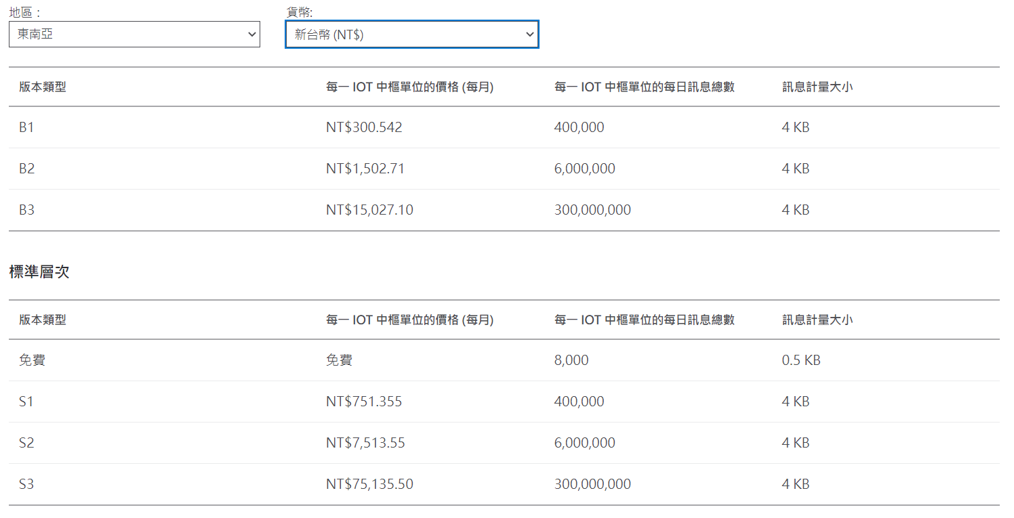
Basic or Standard tier?
(Ref:https://azure.microsoft.com/zh-tw/pricing/details/iot-hub/)

Slide 47
Azure IoT Hub Quota
Charge Unit: 4KB
Batch Daily Volume:
Type1: 0.18 KB x 60s x 60m x 24H x 12 Lines = 186,624 KB
Type2: 0.98 KB x 60/10s x 60m x 24H x 12 Lines = 101,606 KB
Total: 288,230 / 4 KB = 72,057 Units
Real-time Daily Count:
Type1: 60s x 60m x 24H x 12 Lines = 1,036,800 records
Type2: 60/10s x 60m x 24H x 12 Lines = 1,036,80 records
Total: 1,036,800 + 1,036,80 = 1,140,480 Units

Slide 48
Summary

Slide 49
沒有最好的架構、只有最合適的架構
經驗不是放諸四海皆準的規則、只是借鏡
因地制宜!

Slide 50
Contact:
Carl_yang@kingston.com.tw
PPT:
https://github.com/carlyang920/twMVC2021-42.git

Slide 51
Thanks for joining!
Notes:
Thanks for joining us! Have a great conference!

